Slide 1
Explore the Application of Diffusion Model in Video Content Creation
Haiyun Xiao
Yu Li
Haichen Pang

Slide 2
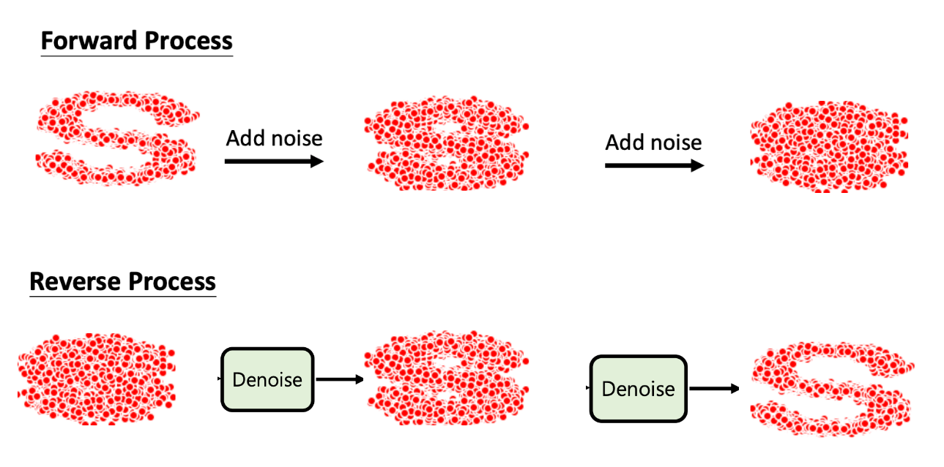
Exploration of the Stable Diffusion Model
1.1 Base Idea

Slide 3
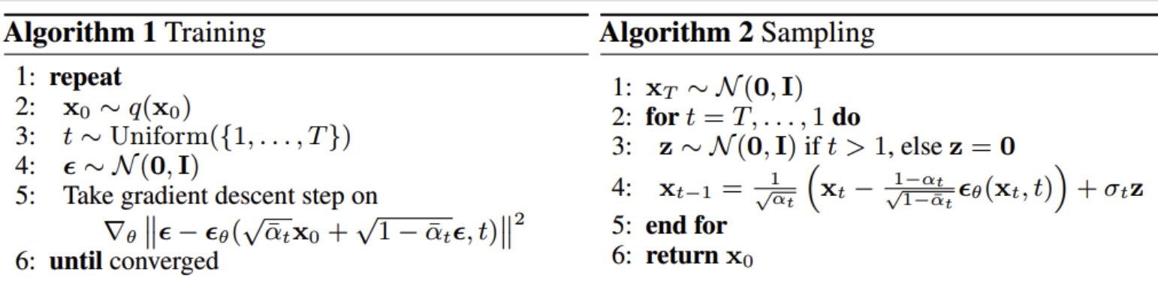
1.2 Psudo Code Algorithm

Slide 4
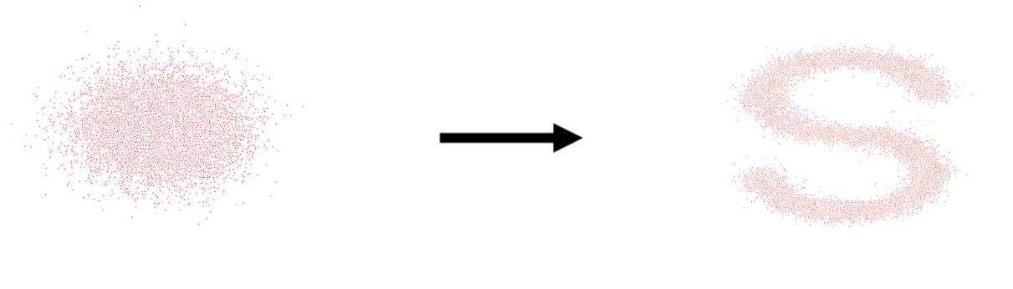
1.3 Training and Sampling use only one data sample (version 1)

Slide 5
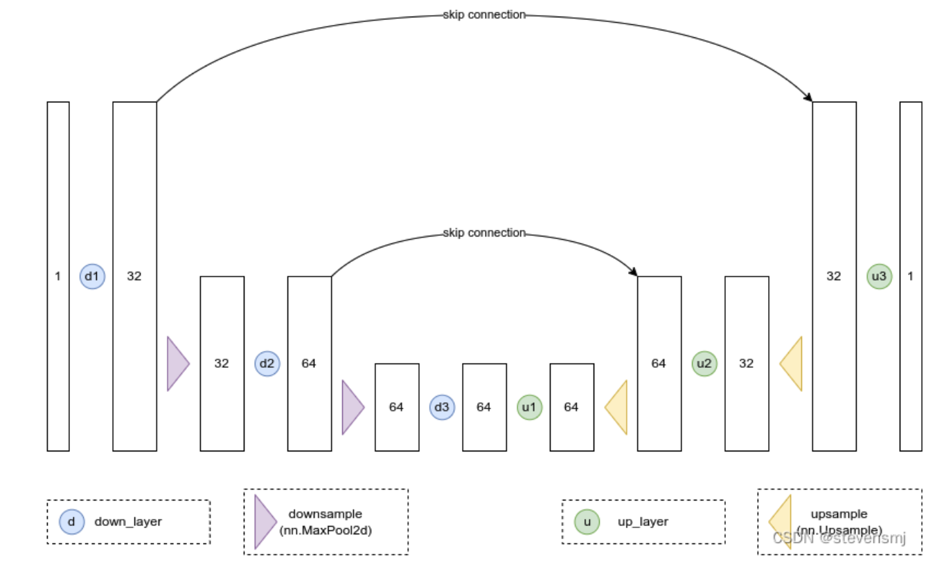
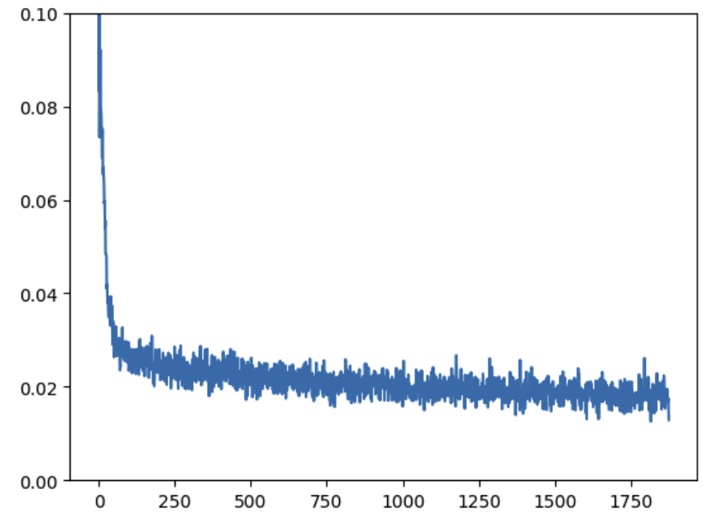
1.4 Using MNIST dataset and BasicUNet (version 2)

Slide 6
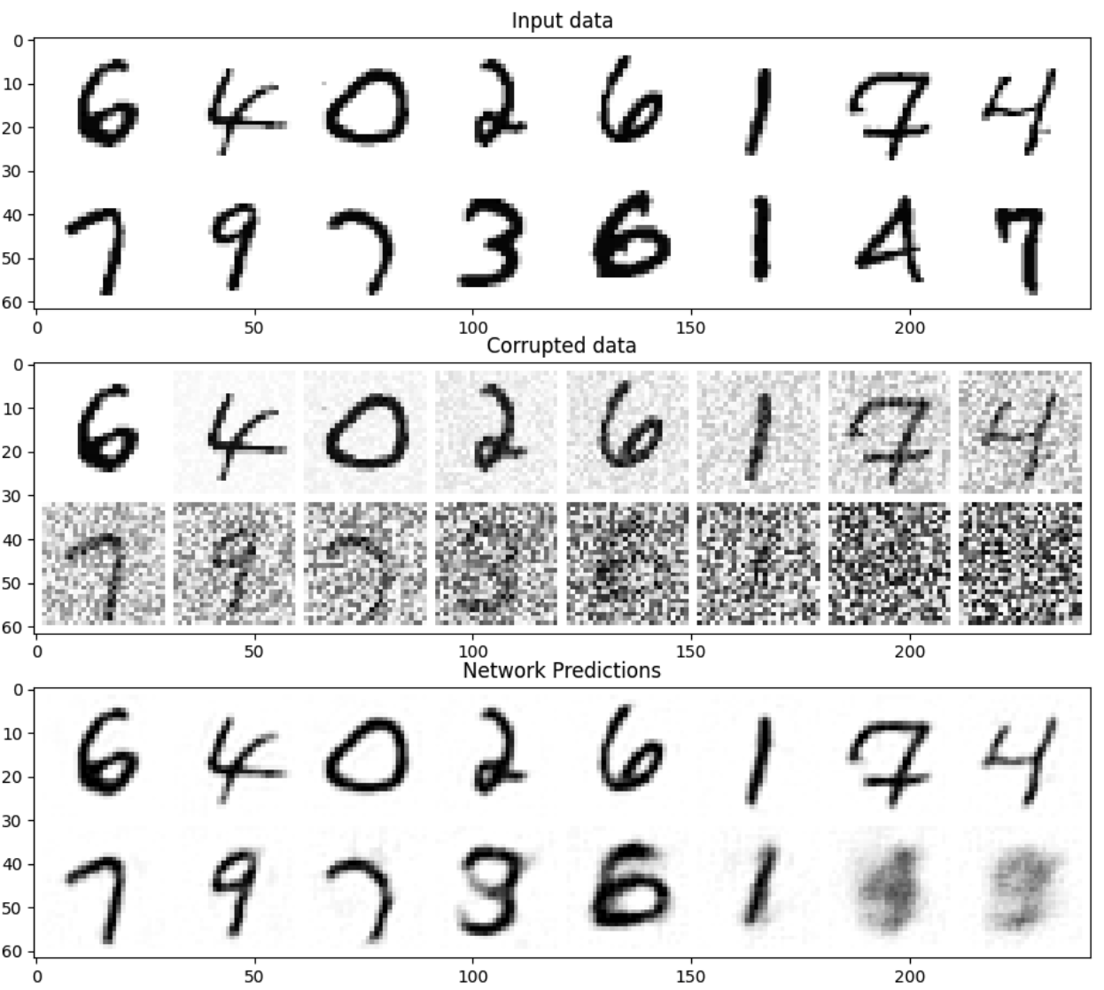

Slide 7
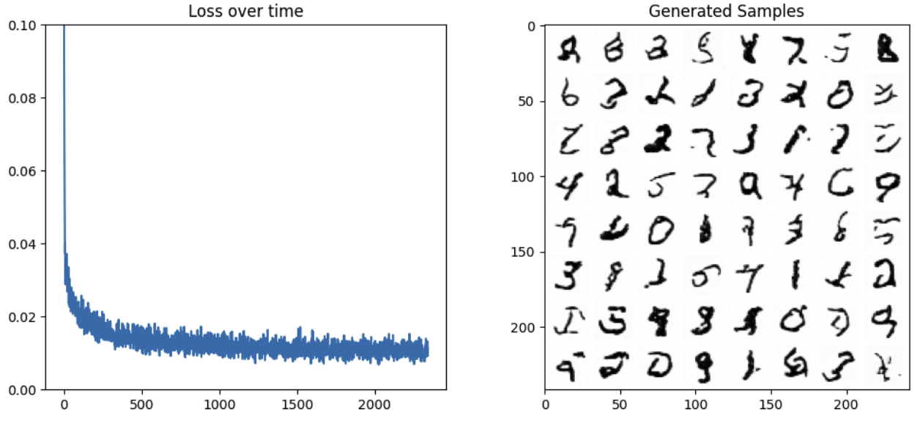
1.5 Using MNIST dataset and UNet2DModel from the Diffusers library (version 3)

Slide 8
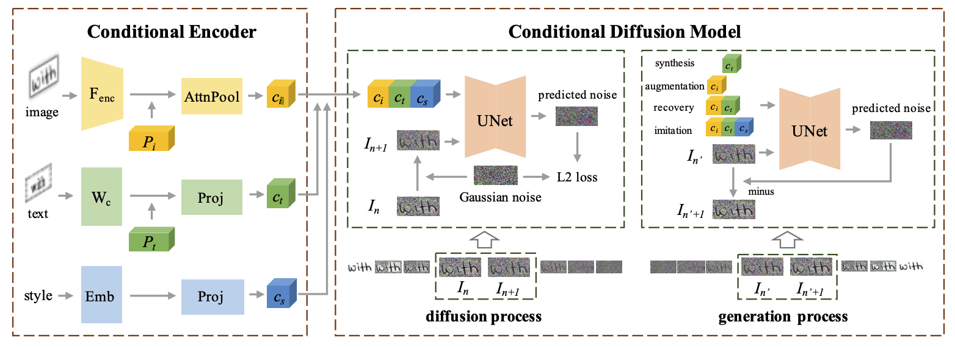
1.6 Text to image generation need more complex models

Slide 9
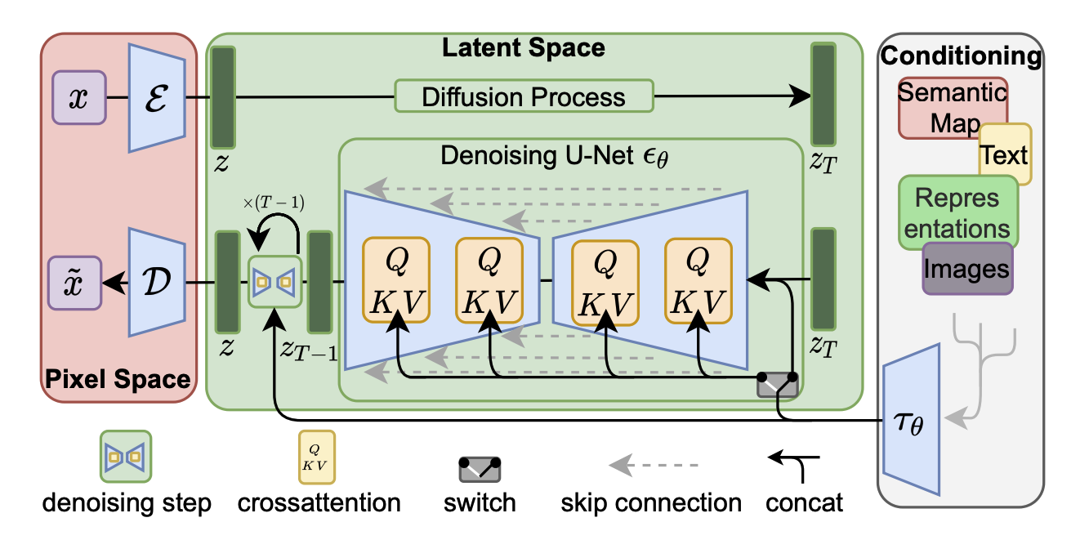
1.7 Latent diffusion model introduction (Architecture in the original paper)

Slide 10
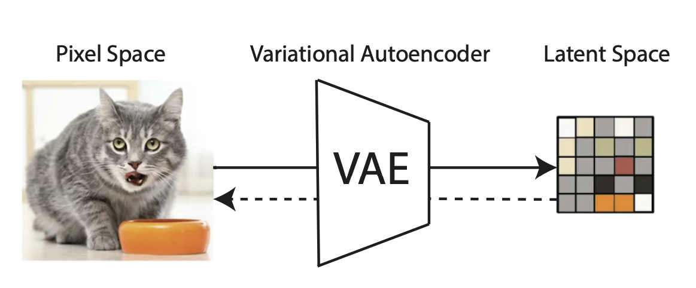
LDMs: Autoencoder

Slide 11
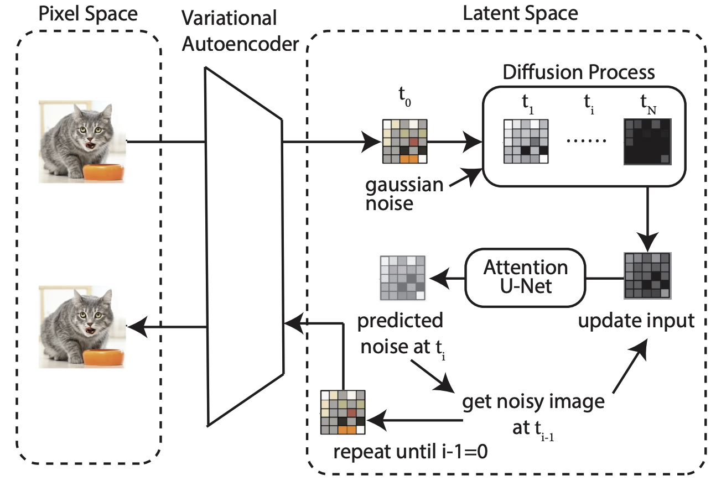
LDMs: Autoencoder & Denoiser

Slide 12
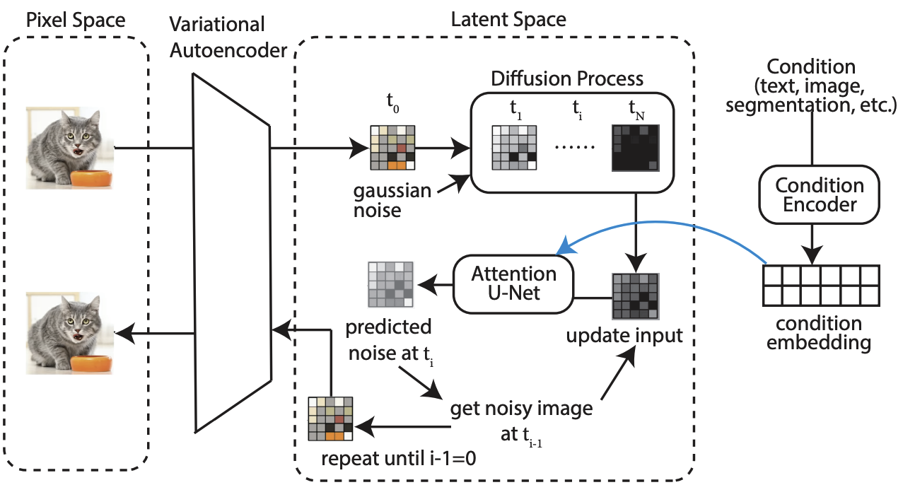
LDMs: Autoencoder & Denoiser & Conditioning

Slide 13
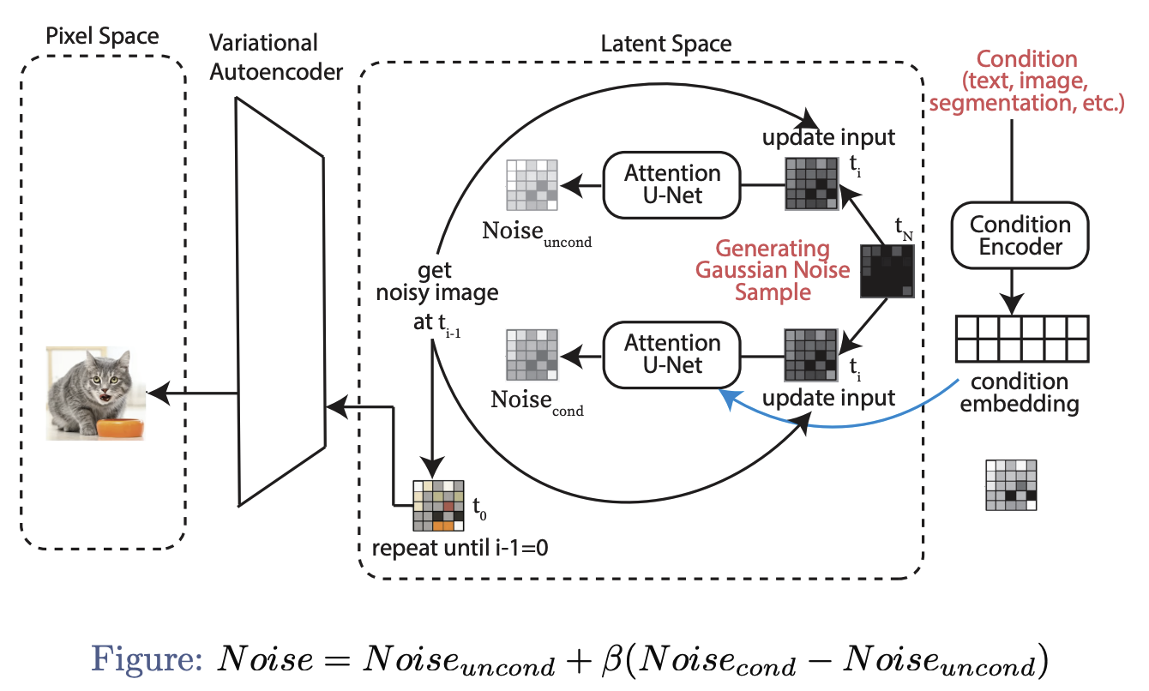
LDMs: New-Image Generation

Slide 14
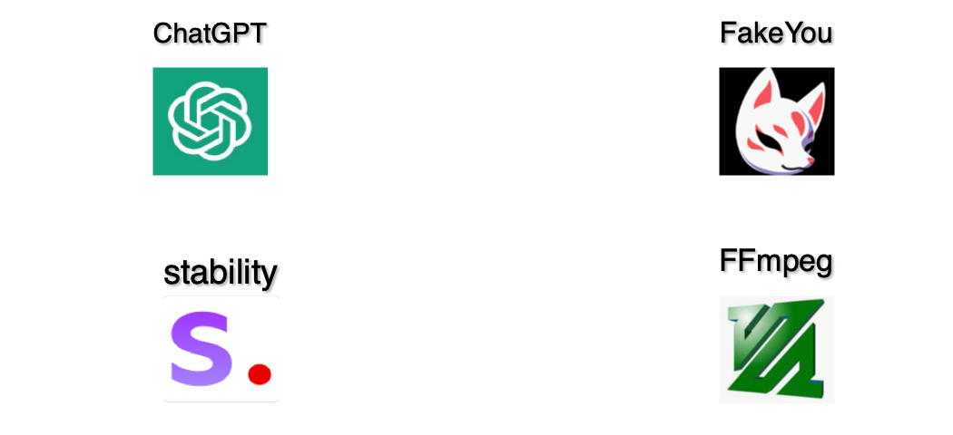
2. Text to video generation using diffusion model
Tools we use

Slide 15
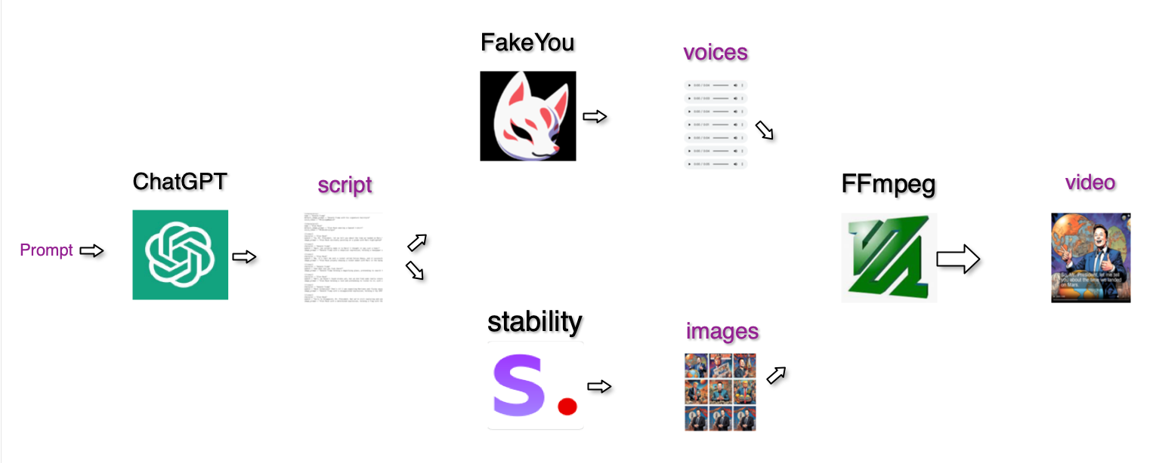
How it works
Modified from an open-source project (https://github.com/joshmoody24/sitcom-simulator)

Slide 16
Limitations of this approach
Only dialogue-based videos, Limited range of character selection.
Comic book style video.
Unable to fine-tune, unable to control at a granular level.

Slide 17
What we gained from the whole project
1. Understood the basic principle of the diffusion algorithm.
2. Trained the basic version of the diffusion model locally.
3. Explored an implementation idea for generating videos from text.

